Slide 1

Over The Air Update Reference Diagrams
©Aritron Technologies Pvt Ltd.

Slide 2
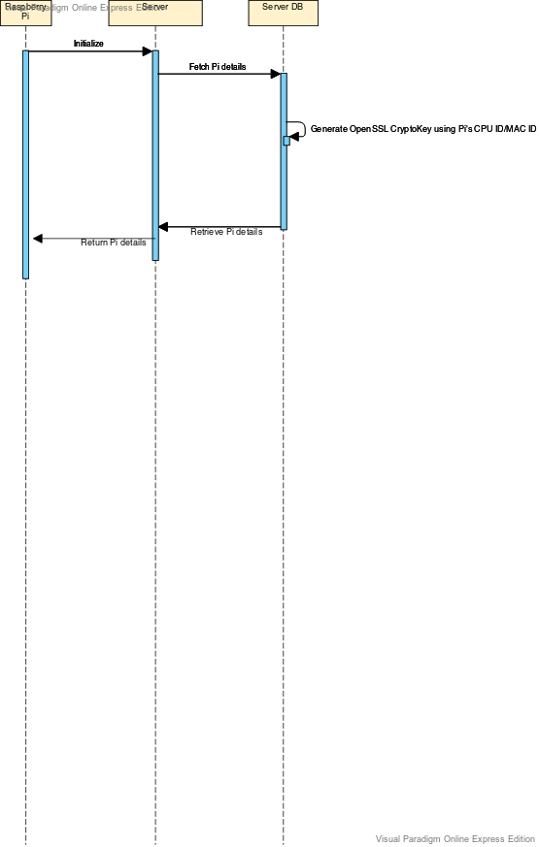
OpenSSL Cryptographic key to be generated during Initialization
©Aritron Technologies Pvt Ltd.

Slide 3
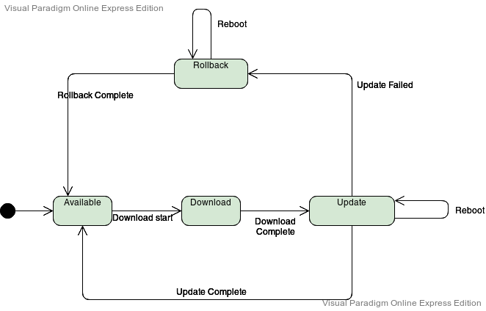
Marker File state maintained during Update process
©Aritron Technologies Pvt Ltd.

Slide 4
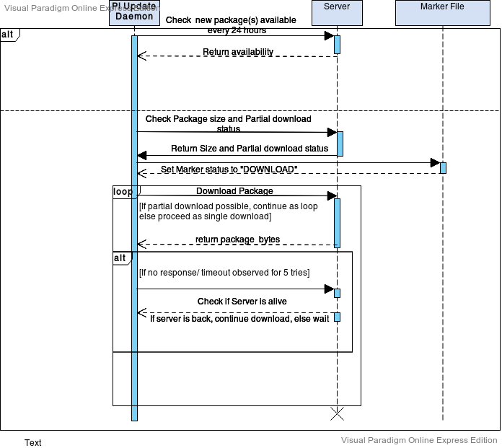
Package Download Sequence Diagram
©Aritron Technologies Pvt Ltd.

Slide 5
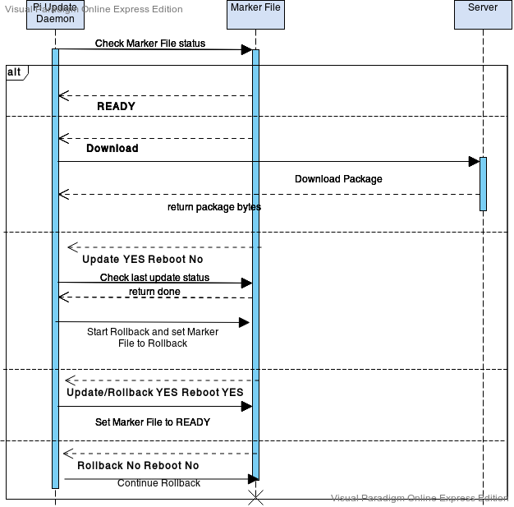
Update Daemon after Reboot
©Aritron Technologies Pvt Ltd.

